Slide 1



Tennis ATP Tour Analysis R-Shiny DSS App Final Project
MGMT 590
Using R for Analytics

Slide 2
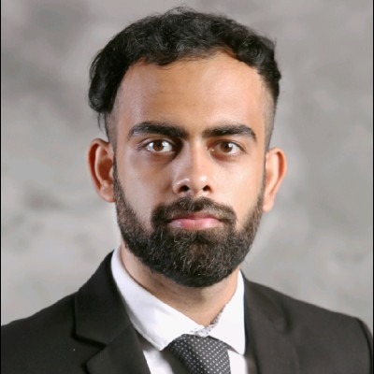

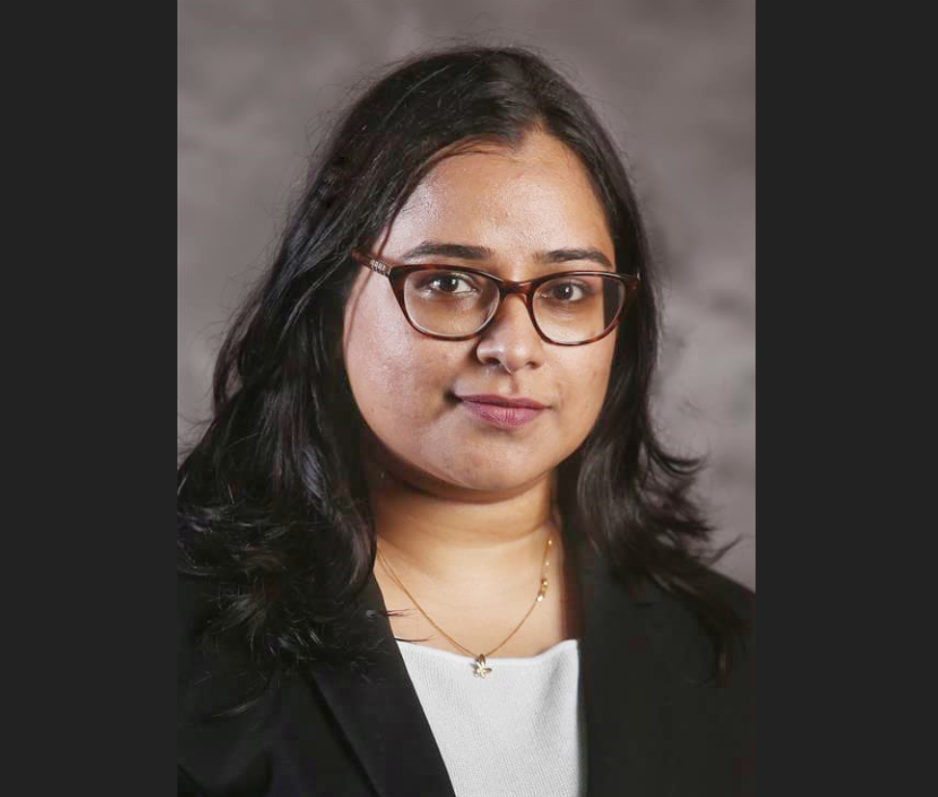
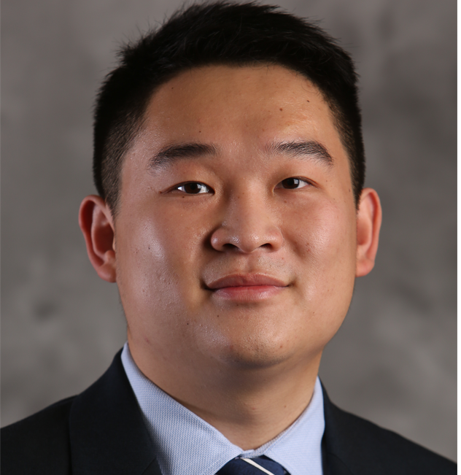
Meet the Team
Utkarsh Bajaj
MS-BAIM ‘22
Aman
Bhargava
MS-BAIM ‘22
Padma Dwivedi
MS-BAIM ‘22
Rubin
Mao
MS-GSCM ‘22

Slide 3



Agenda
Business Problem
Our Methodology
Model Functionality
App Walkthrough
Future Scope

Slide 4

Business Problem
One-Stop website for tennis fans
Player statistics dating back to year 2000, i.e., start of the modern era
Player rankings
Win predictions

Slide 5


Our Methodology
Implement one-stop website using R-Shiny DSS
Data Collection
Descriptive analytics for player rankings
GUI Design Framework
Descriptive Analytics for player Stats
Predictive analytics for win probability

Slide 6
Model Functionality
R Packages Used
Player performances assumed to be at same level as in the preceding years
Prediction based on historical data, not taking into consideration other factors like player longevity, form, injuries, etc.
Analysis restricted to top 50 players
Predictive and descriptive analytics, and an interactive dashboard all in one place – Thanks to R and Shiny!
corrplot
fmsb
magick
ggradar
stringr
caret
circilize
corrplot

Slide 7
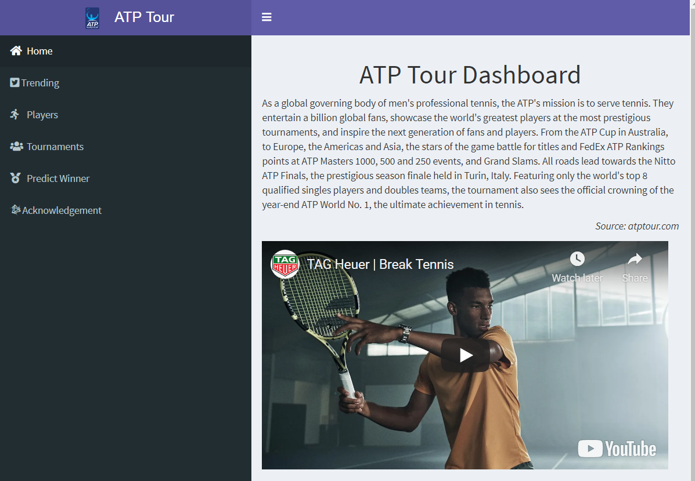
App Walkthrough
Tennis ATP Tour Analysis

Slide 8
Future Scope
Functionality Improvements
PRECSRIPTIVE ANALYTICS FOR PLAYERS TO STRATEGISE
ADD WOMEN’S TENNIS STATS
ADD LIVE SCORES FOR MATCHES
TOURNAMENT WINNER PREDICTIONS
INTRODUCE FUNCTIONALITY FOR BETTING
ADD STATS FOR DOUBLES

Slide 9
Thank You!

